Slide 1
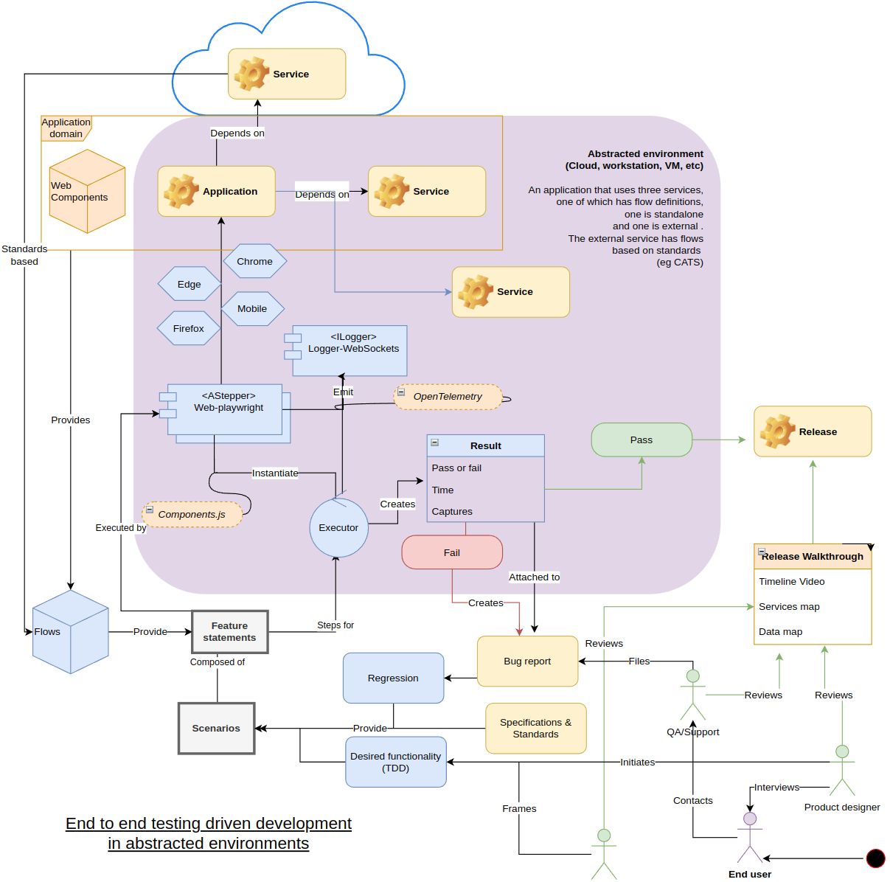
Can deep spec & end to end testing to solve practical GC problems? Jan 25, 2024
Overview diagram

Slide 2
Overview points
Haibun e2e testing - started in 2021 with a goal to support entire GC product lifecycle in an agile loop
Lightweight, transparent and practical way to create specification, tests, documentation
Support cloud & local dev environments, processes
2024 browser based testing gives very deep access to data & services
Support emerging approaches

Slide 3
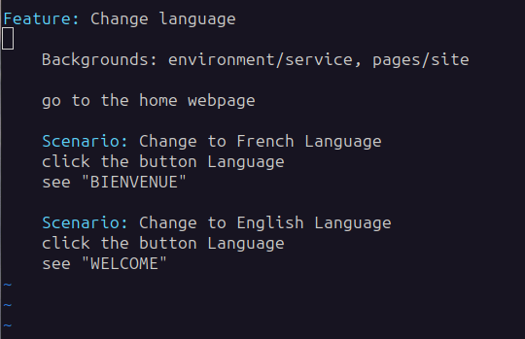
Lightweight, transparent and practical way to create specification, tests, documentation
High-level text descriptions mixed with re-usable plain language flows (“login,” etc)
Create flows manually or using browser recording
Package with minimal low level code in versioned release
Integrate in pipelines
Create live documentation - video, images, reports, traces
Expanding set of concerns - functionality, accessibility, carbon footprint, load testing, etc
Appropriate for a mixed services environment

Slide 4
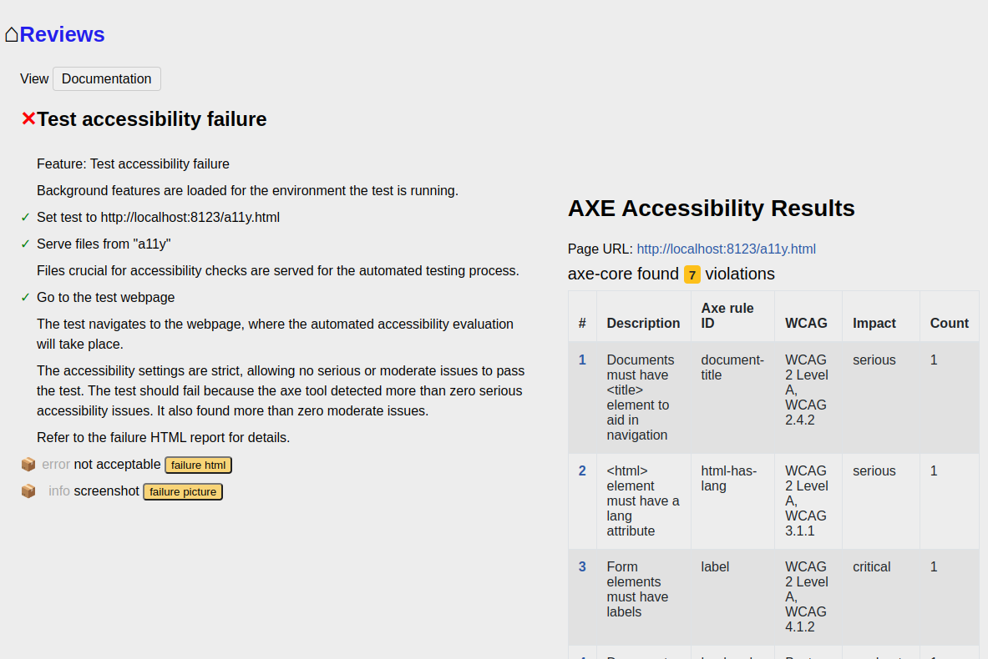

Slide 5
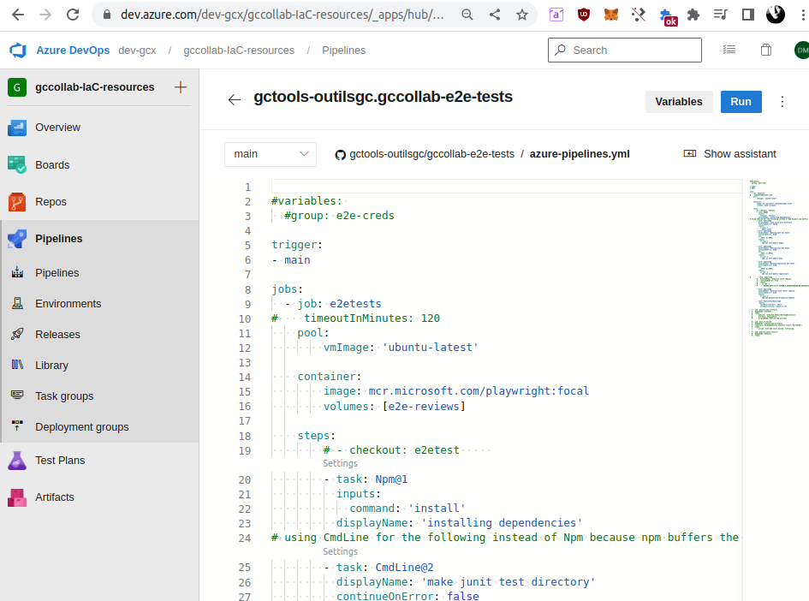
Support cloud & local dev environments, processes @haibun/azure
@haibun/cli
@haibun/core
@haibun/domain-storage
@haibun/domain-webpage
@haibun/out-review
@haibun/out-xunit
@haibun/storage-fs
@haibun/web-accessibility-axe
@haibun/web-playwright @haibun/load-testing

Slide 6
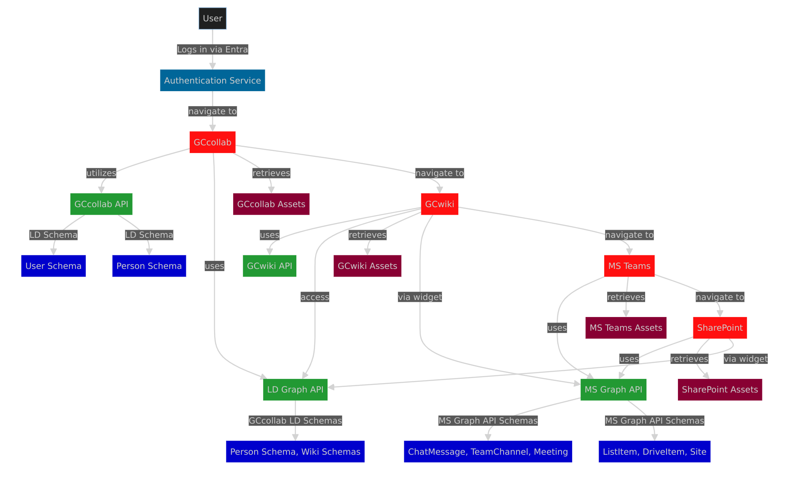
2024 browser based testing gives very deep access to data & services
Practical functional testing
Create maps between services to understand, relate services & data

Slide 7
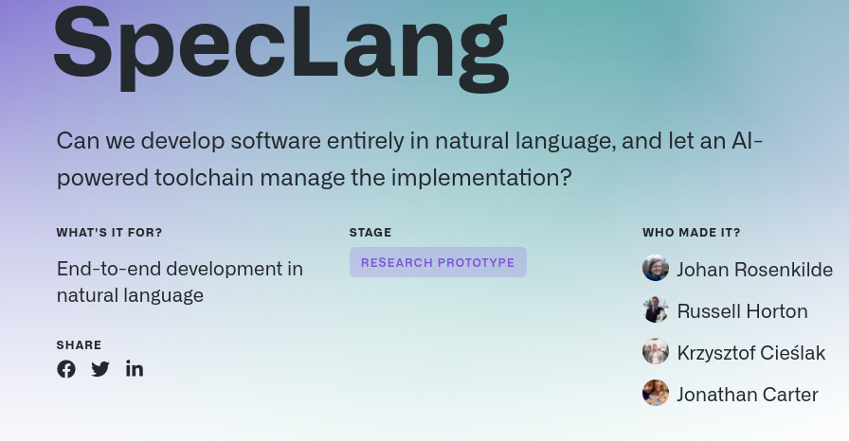
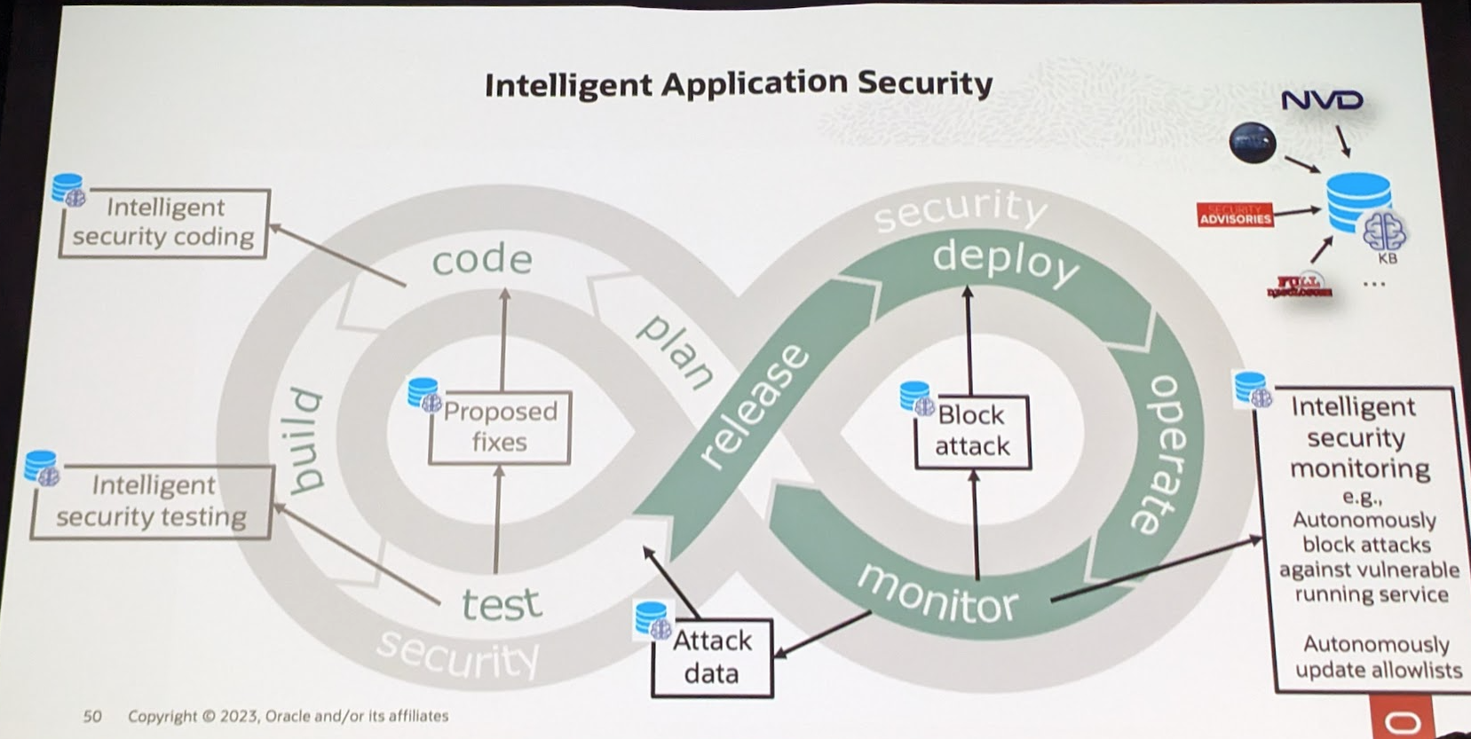
Support emerging approaches
Constantly updated security verification, documentation
Tested code generation, grounded AI support through comprehensive insight of services

